Slide 1
Introduction to Wireless LAN II

Slide 2
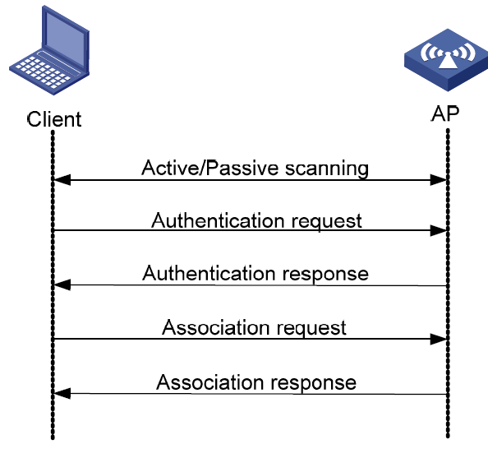
WLAN MAC LAYER
Medium Access Control (MAC) – sub layer of Data Link Layer
In WLAN, MAC layer is responsible to control how the MSs behave towards the channel.
Some of the tasks of MAC layer in WLAN:
Scanning
Authentication
Association
Power saving mode

Slide 3
MAC Layer Operation Mode
In WLAN, the medium to be access is the Radio Frequency (RF), which is a shared medium.
All MS and AP can only hear one frequency at a time to communicate with each other, there must be turns for the MS to use the RF – avoid collisions.
Reason to avoid collisions
Degrade performance.
To avoid packet/data loss at receiver.

Slide 4
MAC Layer Operation Mode
Coordination Function
Process for the MS to take turns using the medium
A way to avoid collisions
In IEEE 802.3 wired network, the Carrier Sense Multiple Access/ Collision Detection (CSMA/CD) is used to detect collision
In wireless networks IEEE 802.11 , it is impractical to transmit and receive on the same radio channel at the same time
In wireless networks, CSMA/CD is not suitable
MS cannot transmit data and listen to any collisions at the same time
The medium itself can only be used for either one of this process; receive or transmit
we cannot assume that all stations hear each other (which is the basic assumption of the collision detection scheme)

Slide 5
IEEE 802.11 Coordination Function
For WLAN, Carrier Sense Multiple Access with Collision Avoidance (CSMA/CA) is used to avoid collision
IEEE 802.11 standard defines two types of coordination function;
Distributed Coordination Function (DCF) – for asynchronous contention based distributed access to the channel.
Point Coordination Function (PCF) – for centralized, contention-free access

Slide 6
Distributed Coordination Function (DCF)
CSMA/CD is used to handle collisions after it occurs (by retransmitting the damaged packet) but CSMA/CA avoids the collisions altogether
DCF adopts the IEEE 802.3 CSMA/CD mechanism with several modifications, known as the CSMA/CA
DCF is used specifically for the contention-based channel access method

Slide 7
Distributed Coordination Function (DCF)
Any MS can attempt to transmit data at any time it wanted
Problem occurs when two computers start to transmit data at the same time, where a collision will occur
To avoid collisions, the MS must firstly listen to the network (carrier sense) to make sure no other MS are transmitting data

Slide 8

Distributed Coordination Function (DCF)
Listen to network
Nobody is talking!
Wait random time [128]
Random time: [0]
Transmit!
A and D wants to transmit data
A and D identifies the network is idle
A and D do not transmit data directly after
identifying that the network is idle.
Instead A and D wait for a random
amount of time (contention period)
A
E
When the network is identified as idle
for the contention period of time, the
node with the shortest contention period
will transmit the data
Listen to network
Nobody is talking
Wait random time [256]
Wait random time [128]
B
D
C

Slide 9
Distributed Coordination Function (DCF)
CSMA/CA has all the MS to wait for a random amount of time, T_{wait} before transmitting data
T_{wait} consists of DCF Interframe Space (DIFS) and Backoff Interval (BI), shown as below equation
BI is random number, generated from a range of values called the Contention Window (CW).
Extra notes:
http://www.invocom.et.put.poznan.pl/~invocom/C/P1-4/p1-4_en/p1-4_8_2.htm
T_{wait} = DIFS + Backoff Interval (BI)

Slide 10
Distributed Coordination Function (DCF)
Scenario:
Firstly, Station D wants to send data to Station C
After data is successfully from D to C, B is then transmitted data to A
DIFS
backoff interval
(8 slots)
RTS
SIFS
DATA
DIFS
backoff interval
(7 slots)
…
Station D
transmission deferred
SIFS
CTS
SIFS
ACK
…
Station C
residual backoff time
(3 slots)
DIFS
backoff interval
(11 slots)
DIFS
RTS
SIFS
DATA
…
Station B
transmission deferred; backoff timer=3
SIFS
CTS
…
Station A
time
RTS : Request to Send, CTS:Clear to Send

Slide 11
Point Coordination Function (PCF)
contention-free based method to access the channel
a point coordinator, usually an AP is required to coordinate the polling process
AP follows the PCF Interframe Space (PIFS) interval as a basis for accessing the medium
The AP senses the medium at the beginning of each contention-free period
If the medium is idle after the PIFS interval, the AP sends a beacon frame to start polling

Slide 12
Point Coordination Function (PCF)
One of the fields of the beacon frame contains a value that indicates the length of time that PCF (polling) will be used
When the MS received the beacon frame, the MS must not do any transmission for that length of time
Then the AP sends out another frame to a specific MS, granting permission to transmit data to any destinations
If it has nothing to send, the MS will send back a null data frame back to the AP
each MS on the wireless network will be asked in sequence, whether they wanted to transmit data.
If an MS wants to transmit the data, the network will give permission to the MS to transmit data, while the other MS must wait.
http://www.invocom.et.put.poznan.pl/~invocom/C/P1-4/p1-4_en/p1-4_8_2.htm

Slide 13


Point Coordination Function (PCF)
Do not send anything! I want to start polling
PC A, send anything you want
PC B, send anything you want
I don’t have anything to send [NULL]
I want to send something
OK!
OK!
OK!

Slide 14

Request to Send/ Clear to Send (RTS/CTS)
RTS/CTS is another option for collision avoidance.
RTS/CTS is used for Hidden Node scenario

Slide 15

Request to Send/ Clear to Send (RTS/CTS)
I want to send data. Can I send to you?
Yes, I am free now. You are clear to send any data.
Receiving…
Sending…
B
A
C
B wants to transmit to A
Ooh, A is receiving data from someone. Channel is not free now. I shall only listen
B sends RTS to its coverage
A sends CTS to its coverage – Note that C is in A’s coverage
C receives CTS packet from A
C listens and does not send any data
B sends data to A

